Slide 1
Image steganography
CAPSTONE PROJECT
Presented By: Khushi Chourase
Student Name: Khushi Chourase
College Name & Department: Central University of Jharkhand & Dept. of Computer Science Engineering

Slide 2
OUTLINE
Problem Statement
Technology used
Wow factor
End users
Result
Conclusion
Git-hub Link
Future scope

Slide 3
Problem Statement
In the digital age, safe communication is essential. Common encryption methods can attract unwanted attention, increasing the risk of interception. Steganography provides a secret approach by integrating messages into the image. Our project presents an image system that is protected by a password to ensure the concealing and restoring of messages. With an intuitive interface, it provides a reliable solution for discreet communication in sensitive scenarios.

Slide 4
Technology used
This Project is built using different kinds of modern tools and libraries for most efficient functioning –
Python - Main programming language.
Streamlit - For building the web app UI.
Pillow (PIL) - For handling image processing.
pyngrok (or subprocess with ngrok) - To expose the local Streamlit app to the internet.
io - For handling image file downloads in memory.

Slide 5
Wow factors
This project has some amazing factors which are mentioned below –
This app can hide messages without altering the actual image.
This is a user-friendly interactive app that allows users just to upload an image and encrypt a message or upload an encrypted message and decrypt it
This app can be instantly accessed and shared globally for usage.
This supports varies types of images, thanks to Pillow(PIL).
Message can only be accessed using the correct password.

Slide 6
End users
This system is valuable for:
Cybersecurity Enthusiasts: Gaining hands-on experience with secure communication techniques.
Government & Intelligence Agencies: Enabling covert data transmission.
Journalists & Whistleblowers: Ensuring confidential communication without detection.
Privacy-Conscious Individuals: Protecting personal data securely.
It offers a discreet and secure method for sharing sensitive information without drawing attention.

Slide 7
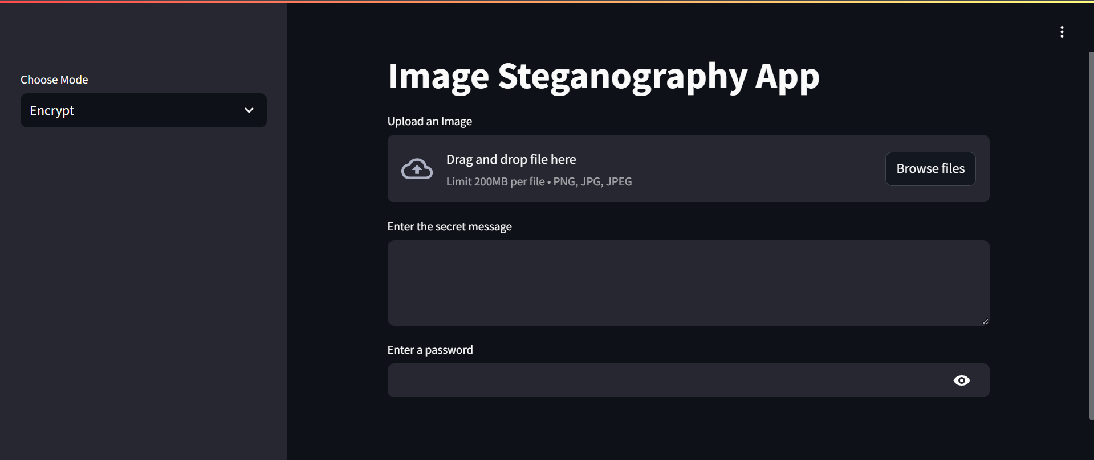
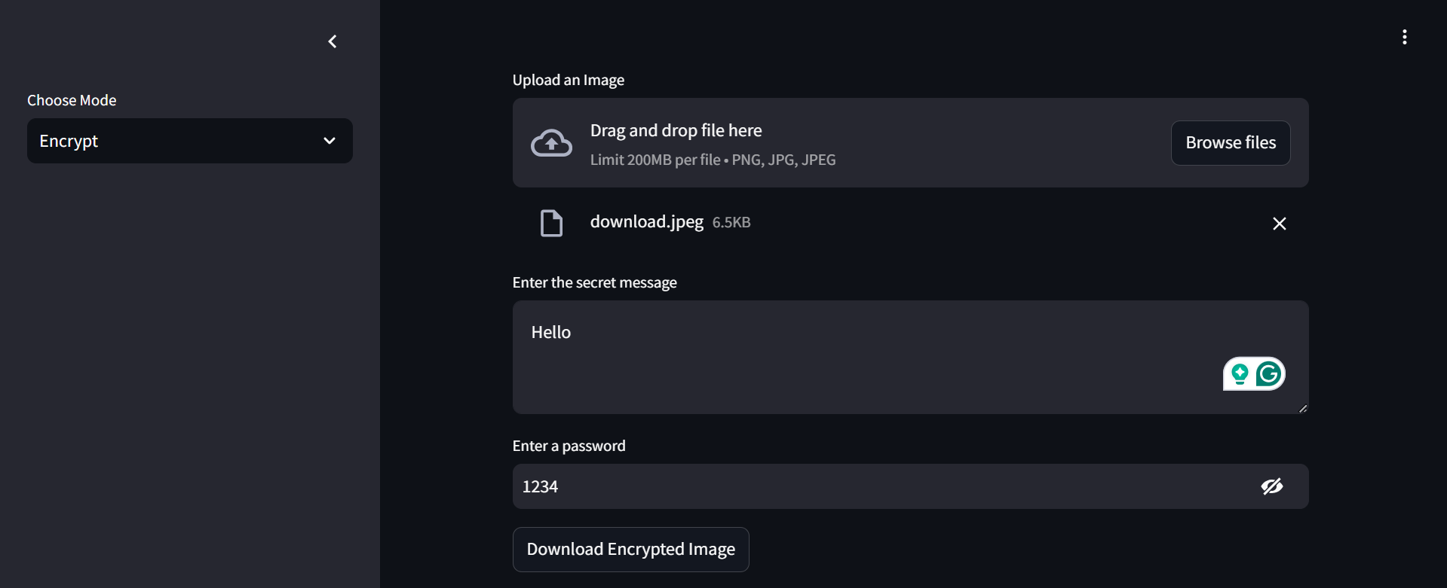
Results
Encryption

Slide 8
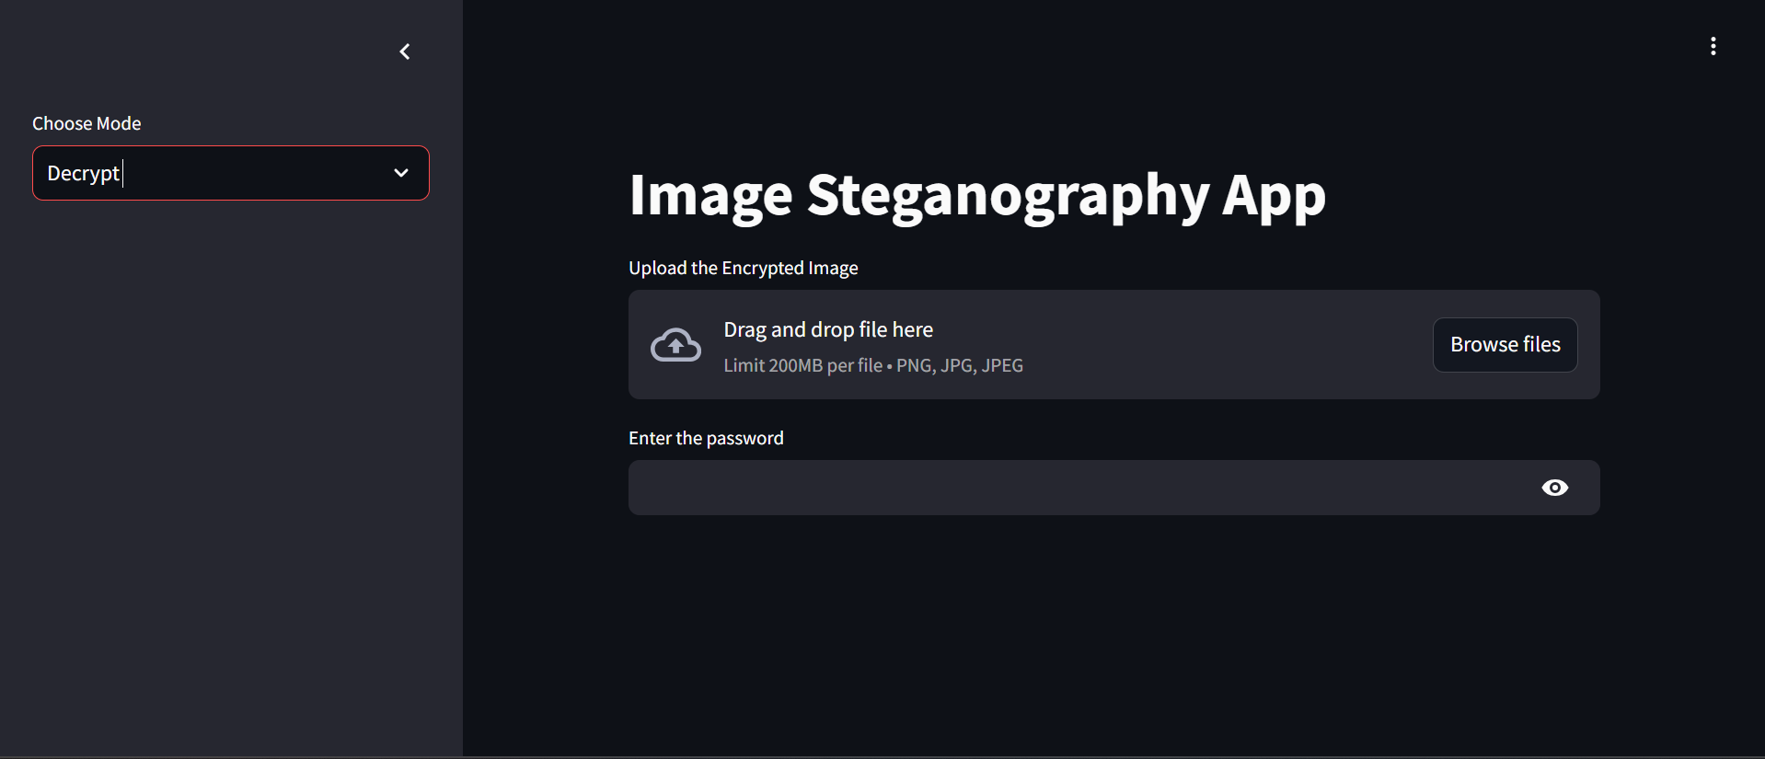
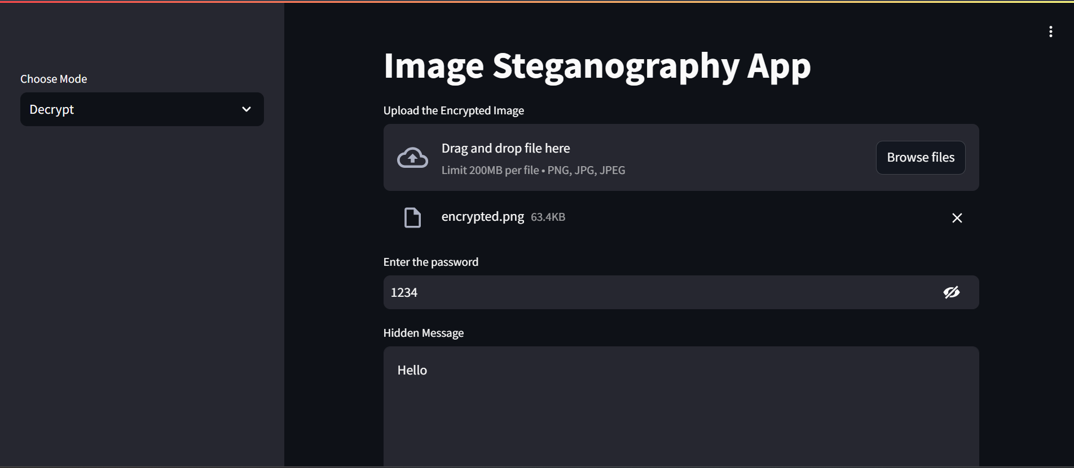
RESULTS
Decryption

Slide 9
Conclusion
This Steganography-Based Secure Communication System enables the concealment of encrypted messages within images, ensuring privacy. Ideal for cybersecurity enthusiasts, journalists, and agencies, it allows secure information transmission discreetly. With a user-friendly Streamlit interface and instant ngrok access, it effectively showcases steganography's critical role in digital privacy and cybersecurity.

Slide 10
GitHub Link
The project is open-source and available on GitHub-
This is the github repository for the image steganography project-
https://github.com/Khushi-C7/Steganography-APP-Aicte-Cybersecurity-Internship

Slide 11
Future scope(optional)
Mobile App Development: Create a lightweight mobile version for seamless and convenient access.
IoT Security Integration: Embed steganographic techniques into IoT devices for secure, low-profile data transmission.
Real-Time Streaming Steganography: Explore methods to conceal data within live video and audio streams for secure communication.
Steganography in Augmented Reality (AR) & Virtual Reality (VR): Implement hidden data embedding within immersive digital environments.

Slide 12
THANK YOU

